Slide 1
Health Care Professionals and Interdisciplinary Care
Brent L. Rollins, RPh, PhD
PHAR 210G
November 21st, 2018
Notes:
1

Slide 2
Previous Material Summary
Syllabus
Paradoxes of the US health care system
Changes over time in hospitals, medicine and pharmacy
Public versus Private sector
US vs. rest of the world
ACA Impact

Slide 3
Student Learning Outcomes
1. Describe the characteristics of a profession.
2. Describe the education, training, and prescribing abilities of various health care professionals.
3. Describe the dynamics of the current and future physician market.
4. List and describe the trends associated with care and health care professionals.
5. Identify and describe the advantages of interdisciplinary care for the various stakeholders.
6. Describe the impact of the professional trends discussed.

Slide 4
What is a profession?
Exist to serve society
But merely providing services that meet the public’s needs does not constitute a profession
5 common characteristics:
Systematic theory and body of knowledge
Professional authority and special privileges

Slide 5
What is a profession?
5 common characteristics:
Community sanction and social utility
Ethical codes and internal control
Professional culture and organizations

Slide 6
Physicians: Education and Training
Medical schools
Allopathic (MD) – 149 schools
Vs. Osteopathic (DO) – 34 schools
PCOM
http://www.pcom.edu/about/what-is-osteopathic-medicine.html
Medical education today is a post-baccalaureate program
First 2 years of in-class education in the basic sciences
Then 2 years of clinical training
Some joint MD/PhD programs
https://students-residents.aamc.org/choosing-medical-career/careers-medical-research/md-phd-dual-degree-training/

Slide 7
Physicians: Education and Training
Licensure = 3 step process
Step 1 – Exam during 2nd year of med school
Step 2 – Exam during 4th year of med school (knowledge and skills test)
Step 3 – Exam during 1st year of residency
Post-graduate training (i.e. residency) in an area of specialization

Slide 8
Physicians: Education and Training
Why do physicians specialize?
https://members.aamc.org/iweb/upload/2017%20Debt%20Fact%20Card.pdf
What are the specialty areas?

Slide 9
Prescribing Authority
Title | Abbreviations | Authority | Notes
Medical Doctor (Allopathic) | MD | Independent
Osteopathic Physician | DO | Independent
Podiatrist | DPM, DSC, PodD | Independent | As appropriate
Dentist | DDS or DMD | Independent | As appropriate
Optometrist | OD | Independent | State Dependent
Veterinarian | DVM | Independent | For animals only
Nurse Practitioner | NP | Dependent | Protocols & co-signature
Physician Assistant | PA | Dependent | Protocols & co-signature
Chiropractor | DC | None
Certified Nurse Midwife | CMW | Dependent | Collaborative agreement – only specific meds

Slide 10
Physicians: By the Numbers
700k+ physicians in U.S.
Close to 50/50 Male/Female – new entrants/graduates
Are there enough physicians?
What about 10 – 15 years from now?
http://www.bls.gov/ooh/healthcare/physicians-and-surgeons.htm

Slide 11
Physicians: By the Numbers
Are there enough physicians?
https://www.aamc.org/download/450420/data/physiciansupplyanddemandthrough2025.pdf
https://news.aamc.org/press-releases/article/workforce_report_shortage_04112018/

Slide 12
Nurses
Largest health care occupation
http://kff.org/other/state-indicator/total-registered-nurses/?currentTimeframe=0
In the 1900’s, the professional development of nurses was one of the key events in the transformation of hospitals.
How?

Slide 13
Nurses: Education and Training
2-year associate degrees – licensed practical nurse (LPN)
4-year degree – B.S. in nursing – registered nurse (RN).
Post-graduate programs include:
Clinical nurse specialist – certified in a specialized area of care (e.g. critical care, surgery, pediatrics)
M.S., DNP and Ph. D. programs
http://www.augusta.edu/nursing/dnp_programs.php
Certified registered nurse anesthetists (CRNA) have advanced training in critical care and anesthesiology.

Slide 14
Nurses: APNs
Nurse Practitioner (CNP)
Education and Training
http://www.augusta.edu/nursing/pmc.php
https://www.aanp.org/all-about-nps/np-fact-sheet
What they can and can’t do – http://www.aanp.org/AANPCMS2/AboutAANP/About+NPs.htm
Diagnose
Prescribe
http://www.aanp.org/all-about-nps/np-fact-sheet
All 50 States
http://www.forbes.com/sites/brucejapsen/2016/04/15/nurse-practitioners-physician-assistants-win-prescribing-authority-milestone/#2d474bc35f08
State Dependent

Slide 15
Physician Assistant (PA)
Education & Training
Most complete a masters program and pass a national certification exam, continuing education, and recertify every 10 years.
www.aapa.org
PCOM - https://www.pcom.edu/academics/programs-and-degrees/physician-assistant-studies/
Prescribing
All 50 States
Facts
https://www.aapa.org/wp-content/uploads/2017/01/Profile-of-a-PA.pdf
https://www.aapa.org/wp-content/uploads/2017/02/PA_MythBusters-final-web.pdf

Slide 16
Allied Health Professions
Physical Therapist
DPT, 3-year post grad program - http://www.apta.org/PostprofessionalDegree/TransitionDPTFAQs/
Hospitals, outpatient clinics, and private offices
Median income - $79,860 http://www.bls.gov/ooh/healthcare/physical-therapists.htm
Occupational Therapist
At least 2 yr graduate program
http://www.bls.gov/ooh/healthcare/occupational-therapists.htm
School systems, hospitals, nursing facilities, etc.

Slide 17
Professional Trends:
Multidisciplinary care
Versus
Interdisciplinary care

Slide 18
Professional Trends:
Interdisciplinary care - Advantages
Patients
Improves care through increased coordination of services
Empowers patients as active partners in care
Can serve patients of diverse cultural backgrounds
Time more efficiently used
HC Profs
Increased professional satisfaction
Increased focus on long-term preventative care
Practitioners can learn new skills and approaches
Encourages innovation
Allows focus on individual area of expertise
http://www.publish.csiro.au/?act=view_file&file_id=AH070330.pdf

Slide 19
Professional Trends:
Interdisciplinary care - Advantages
Educators/students
Multiple health care approaches to study
Fosters appreciation and understanding of other disciplines
Models strategies for future practices
Challenges norms and values of each discipline
HC delivery system
Potential for more efficient delivery of care
Maximizes resources and facilities
Decreased burden on acute care
Facilitates continuous quality improvement efforts
http://www.publish.csiro.au/?act=view_file&file_id=AH070330.pdf

Slide 20
Professional Trends:
Medical Home
Partnership approach in the provision of primary health care:
Accessible
Family centered
Coordinated
Comprehensive
Continuous
Compassionate
Culturally effective
Based on patient-physician relationship and open communication within a team care framework
The primary focus = one central clearinghouse in which all patient medication records are kept up to date

Slide 21
Professional Trends:
Medical Home
http://www.acponline.org/running_practice/delivery_and_payment_models/pcmh/understanding/what.htm
https://www.ncqa.org/Portals/0/PCMH%20brochure-web.pdf

Slide 22
Professional Trends:
QUALITY
“The degree to which health services for individuals and populations increase the likelihood of desired health outcomes and are consistent with current professional knowledge.”
Institute of Medicine (IOM), 2003

Slide 23
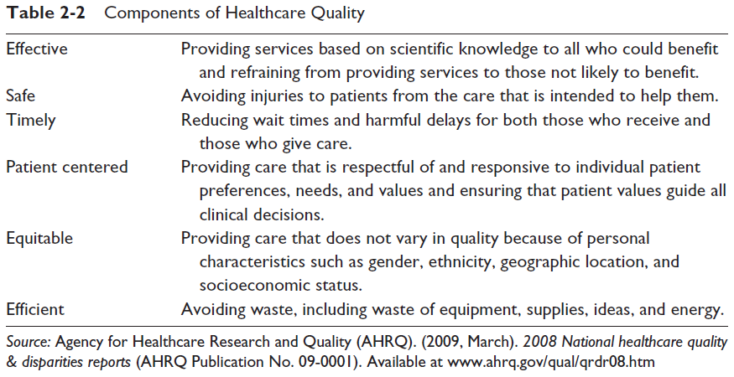
Professional Trends:

Slide 24
Professional Trends: Quality
Patient-centered care
Includes:
1 – de-centralization of services
2 – cross-training of personnel from different departments
3 – interdisciplinary collaboration
4 – various degrees of organizational restructuring
5 – simplification and redesign of work to eliminate steps and save time
6 – increased involvement of patients in their own care
And results in:
1 – improved patient perceptions of quality of care
2 – improved job satisfaction
3 – more effective and efficient use of clinical and non-clinical staff

Slide 25
Professional Trends: Quality
Pay for performance (P4P)
Quality based purchasing. The use of payment methods and other incentives to encourage high quality and patient focused, high value care.
Defined measures
Data collection
Public reporting = includes payment incentives aimed at quality, efficiency, and patient satisfaction.
http://www.pfpsummit.com/

Slide 26
Professional Trends: Quality
Pay for performance (P4P) (and quality) – Affordable Care Act
https://www.cms.gov/Medicare/Quality-Initiatives-Patient-Assessment-Instruments/Value-Based-Programs/Value-Based-Programs.html
https://www.commonwealthfund.org/publications/issue-briefs/2015/may/affordable-care-acts-payment-and-delivery-system-reforms?redirect_source=/publications/issue-briefs/2015/may/aca-payment-and-delivery-system-reforms-at-5-years
2 graphs**
https://www.michigan.gov/som/0,4669,7-192-47796-483121--,00.html

Slide 27
Professional Trends:
Discussion Questions:
What do these trends mean?
What do you think their impact is on pharmacy?

Slide 28
Student Learning Outcomes
1. Describe the characteristics of a profession.
2. Describe the education, training, and prescribing abilities of various health care professionals.
3. Describe the dynamics of the current and future physician market.
4. List and describe the trends associated with care and health care professionals.
5. Identify and describe the advantages of interdisciplinary care for the various stakeholders.
6. Describe the impact of the professional trends discussed.

